Slide 1
SC5010 Assignment Team 7
Phillip Torring
Thiara Sana Ahmed

Slide 2
Table of contents
01
02
03
04
Background & Objective
Exploratory Data Analysis
Data Preparation
05
06
Deep Learning Classification
Results & Insights
Possible Applications

Slide 3
01
Background & Objective

Slide 4

Background: Happywhale NGO
Surveying species and populations for conservation purposes
Thousands of hours spent on identifying whales

Slide 5
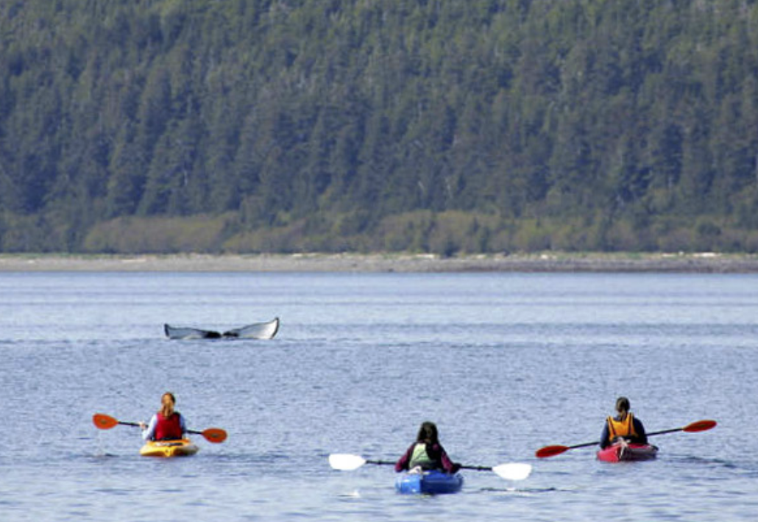
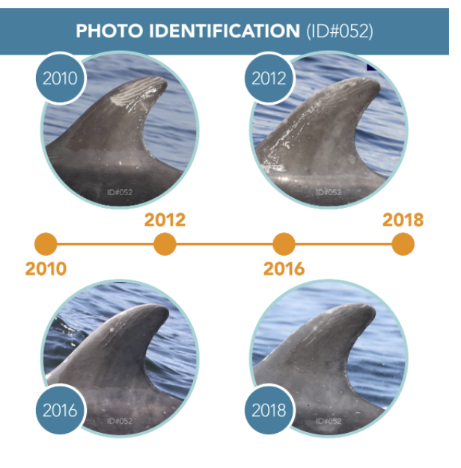
Happywhale dataset
Data-collection
Volunteers from all around the world collect photos
Different organizations and types of data
Species with and without distinct features
Significant dataset
51k+ entries
Including: Image, species, individual ID, and dolphin/whale
30 different species and 27k individuals
57GB of data

Slide 6
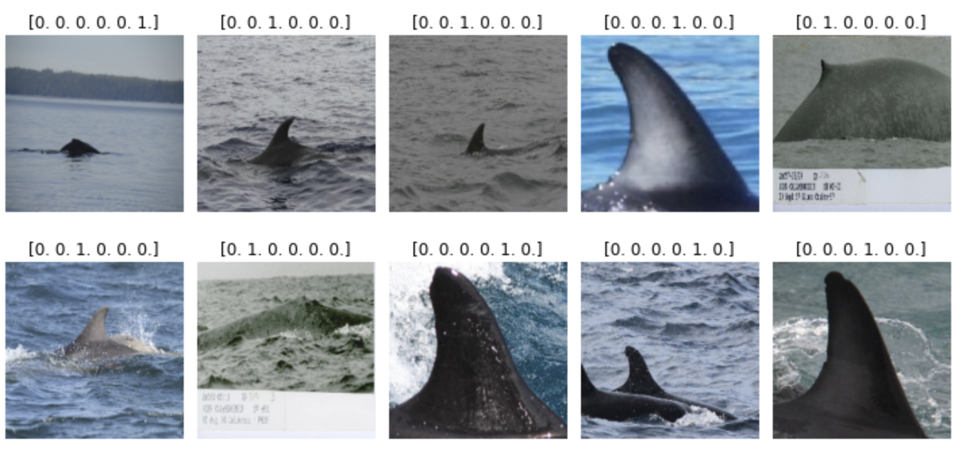
How does the data look?
Varying resolution, size, crop, color, and outliers

Slide 7
02
Exploratory Data Analysis

Slide 8
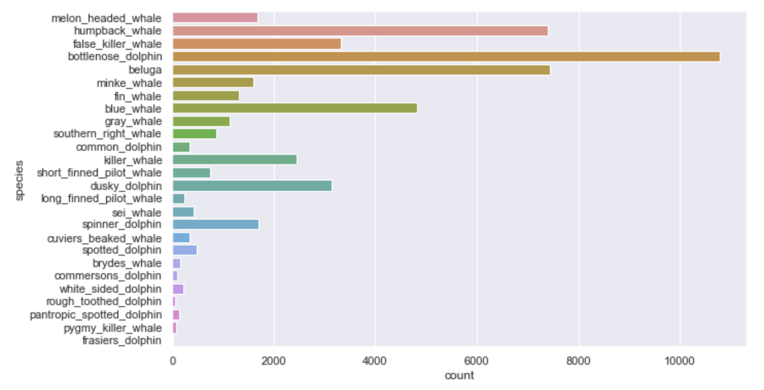
Exploration of data
Significant class imbalance; from 10000+ to 14
Nature of dataset made it difficult to over/undersample.
Data-cleaning: labelling errors
Reducing dataset to 3 common types of whales and dolphins

Slide 9
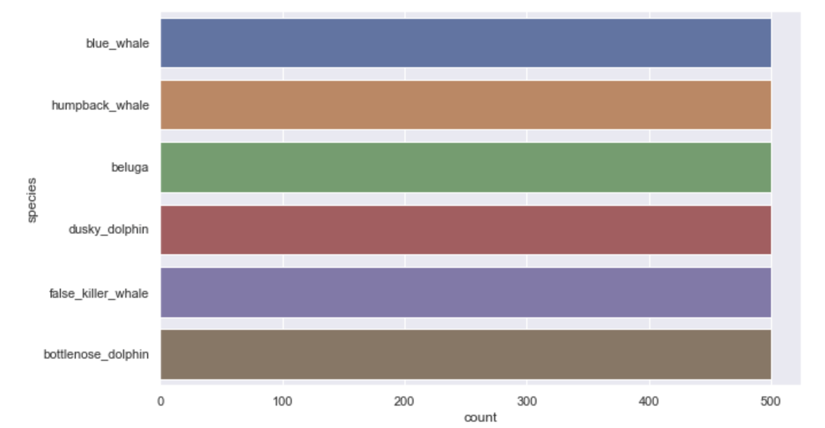
Exploration of data

Slide 10
03
Data Preparation
Object Detection & Image Cropping
YOLOv5 Model

Slide 11
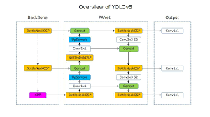
YOLOv5 Object Detection
YOLOv5 is a family of object detection architectures and models pretrained on the COCO dataset
Used a bounding box of dimensions 224x224 as the classification model required images of that size
YOLOv5l model assigned classes to the objects detected, however these classes were not useful, they were not considered
YOLOv5 Model Structure
This method was compared to cropping the center 224x224 pixels of the images

Slide 12
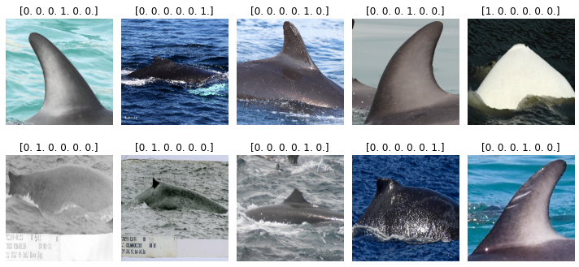
Center Box Cropping

Slide 13
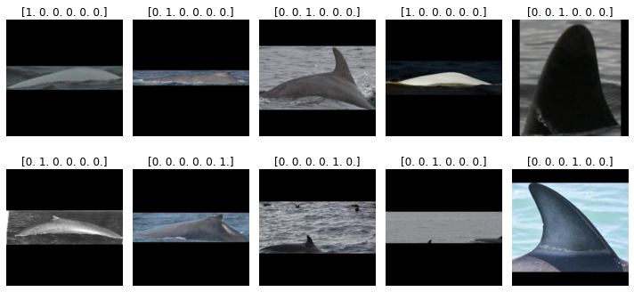
YOLOv5 Cropping

Slide 14
04
Deep Learning Classification
Pre-Trained VGG16 Model

Slide 15
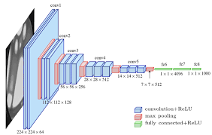
VGG16
Step Goal: Classification of images into Species Classes
VGG16 is a convolutional neural network primarily used for image recognition and classification.
16 layers deep
The model was loaded pre-trained with ImageNet weights to make use of Transfer Learning
VGG16 Model Structure
Notes:
https://medium.com/mlearning-ai/an-overview-of-vgg16-and-nin-models-96e4bf398484
Transfer learning is flexible, allowing the use of pre-trained models directly, as feature extraction preprocessing, and integrated into entirely new models.

Slide 16
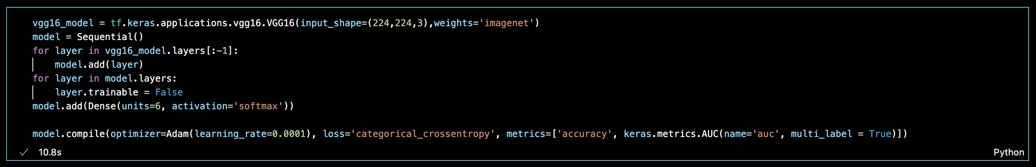
Why VGG16?
Easy to implement
Transfer Learning – Our Image dataset was large, but computational power was limited
ImageNet – contains over 20,000 categories and 14 million images

Slide 17
05
Results & Insights

Slide 18
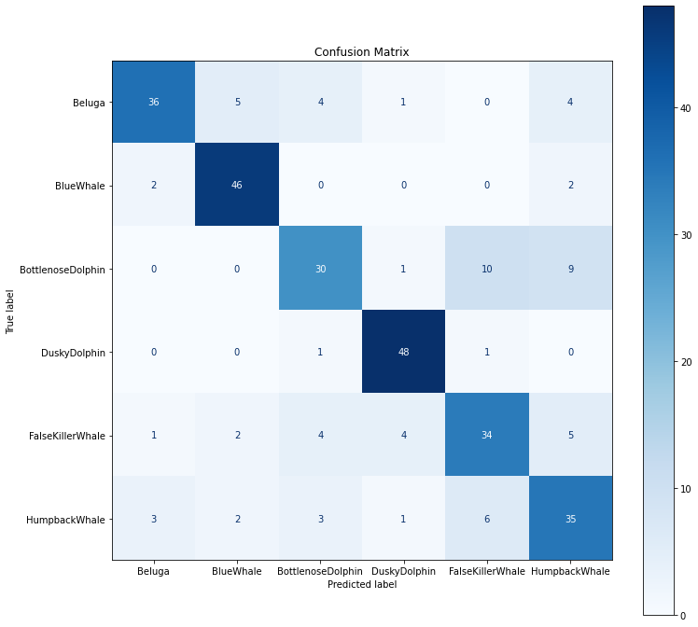
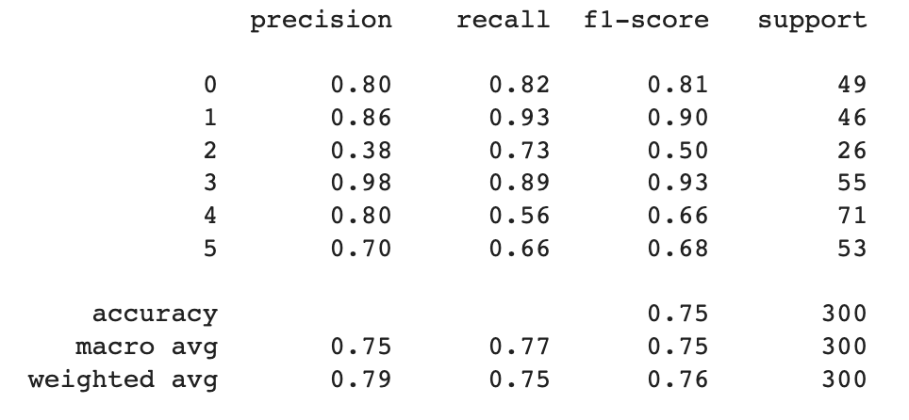
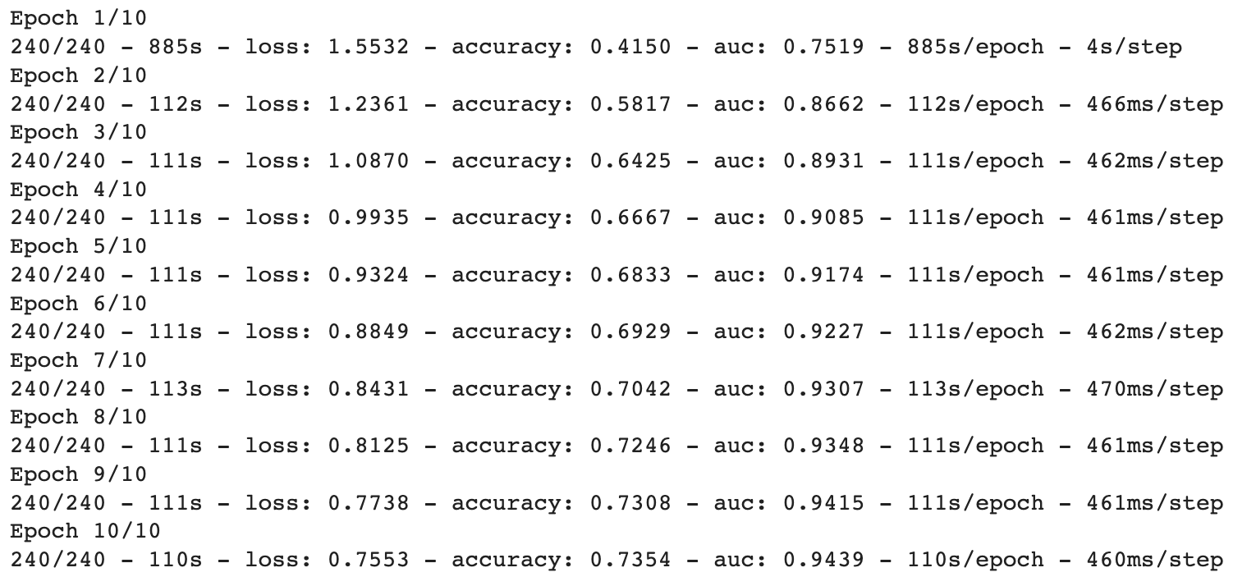
Center Box Cropping Method

Slide 19
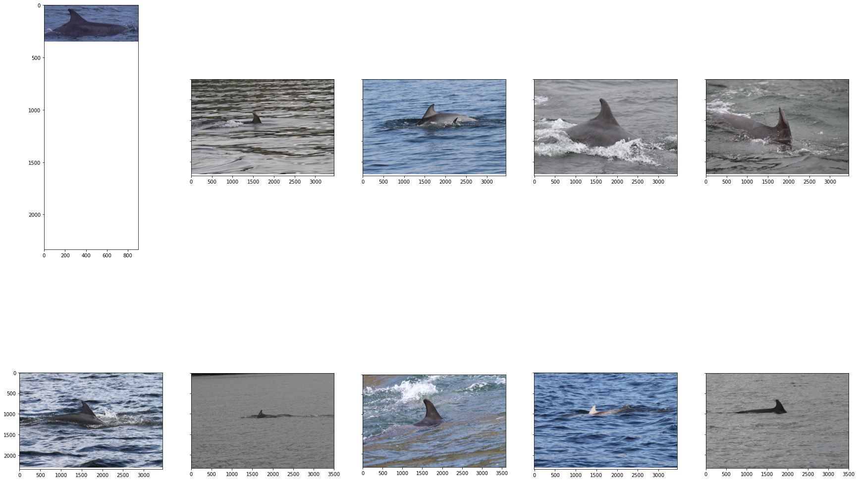
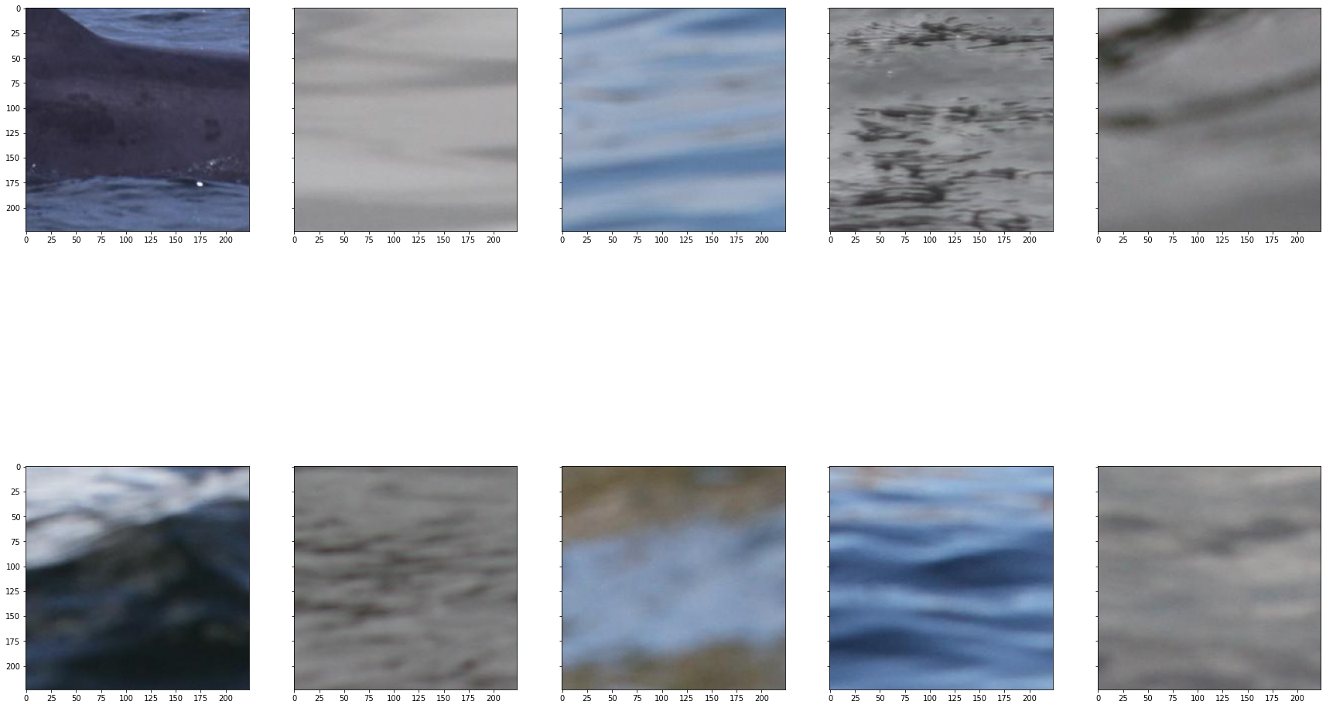
Misclassifications – Bottlenose Dolphin as False Killer Whale
Without Cropping
With Cropping

Slide 20
Misclassifications – Bottlenose Dolphin as False Killer Whale
Without Cropping
With Cropping

Slide 21
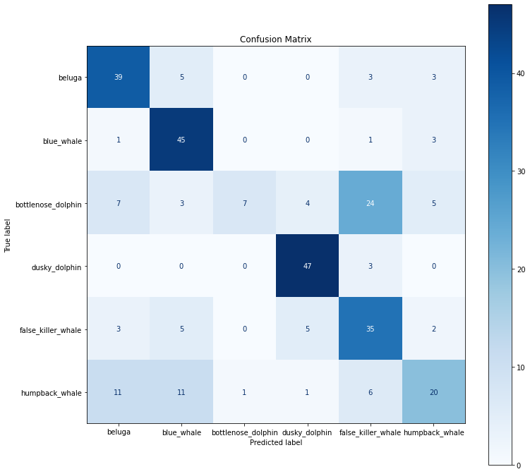
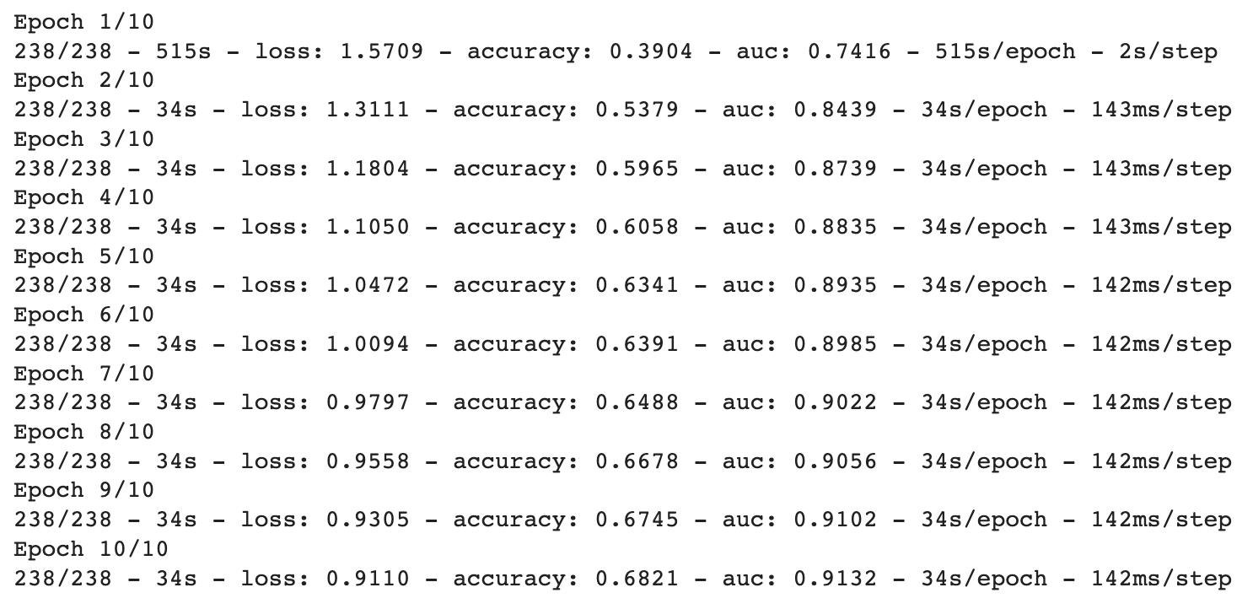
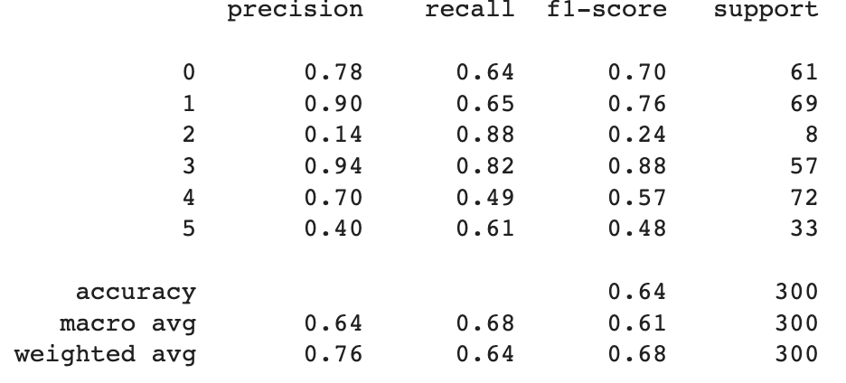
YOLOv5 Cropping Method

Slide 22
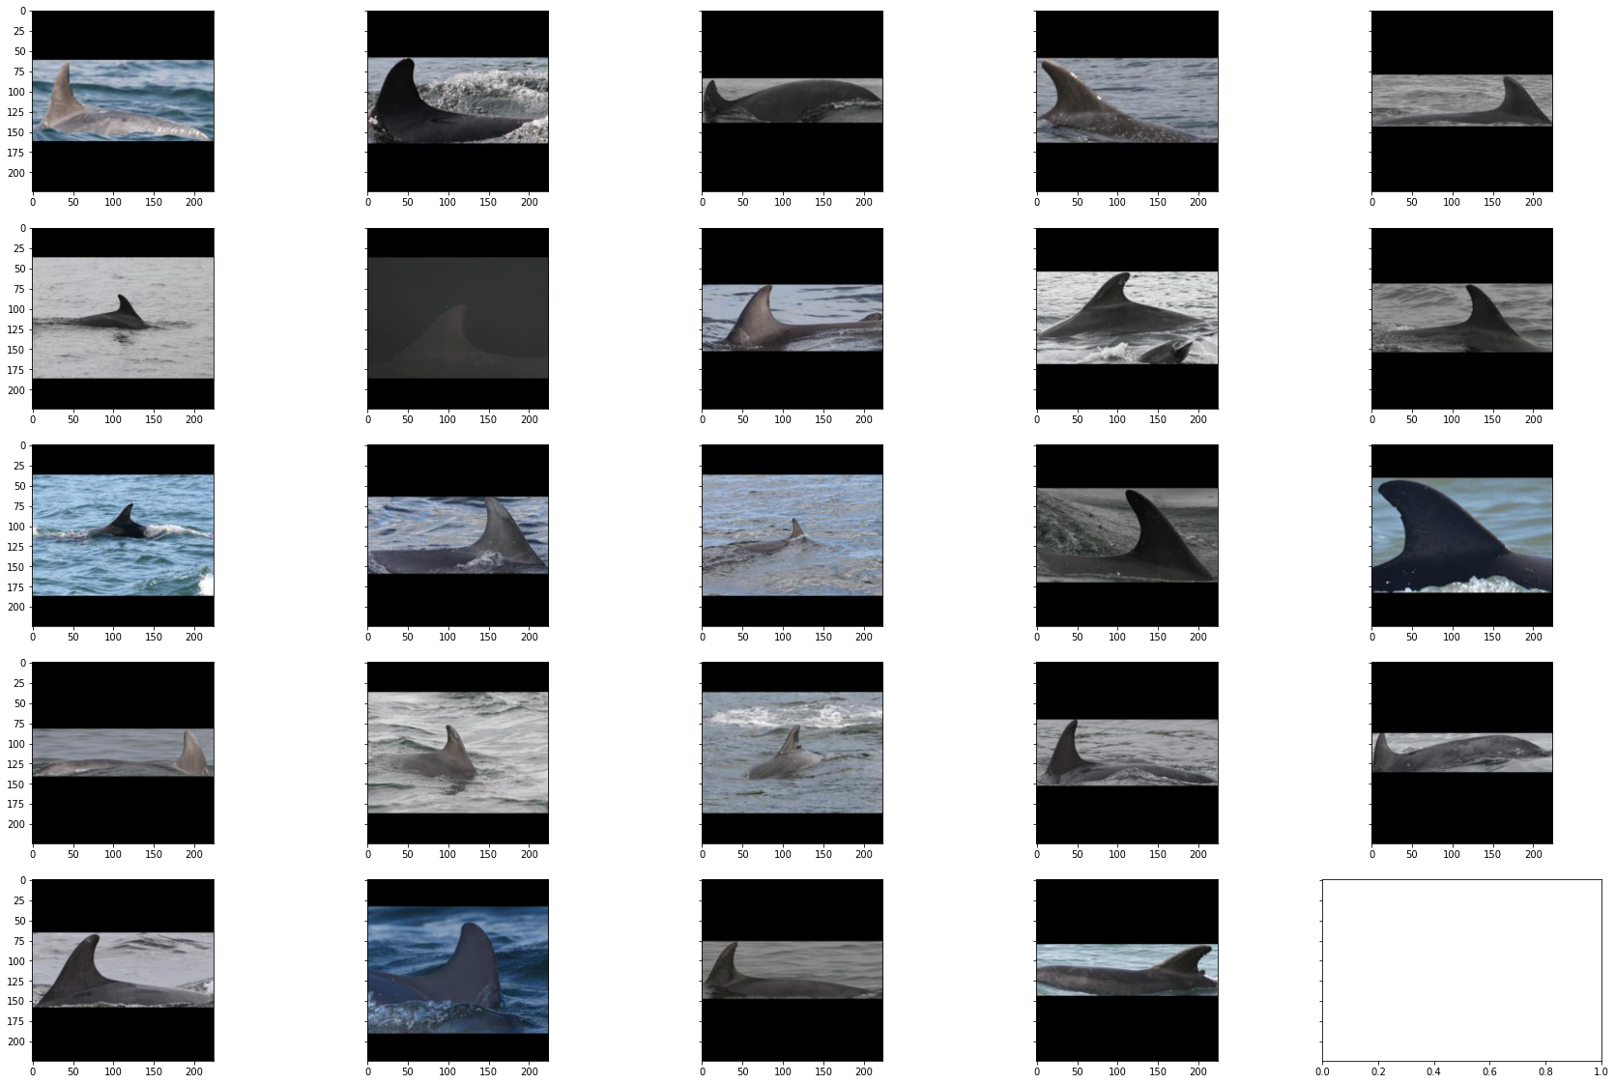
Misclassifications – Bottlenose Dolphin as False Killer Whale

Slide 23
06
Possible Applications

Slide 24
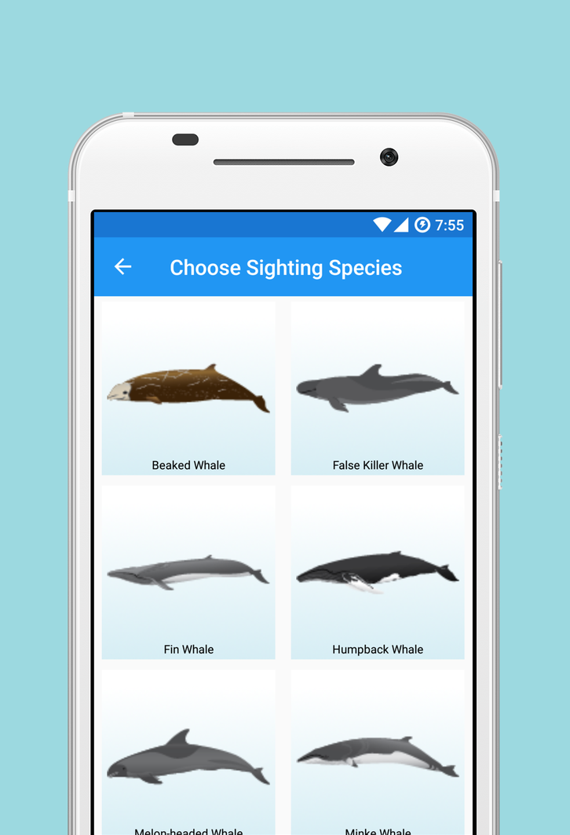
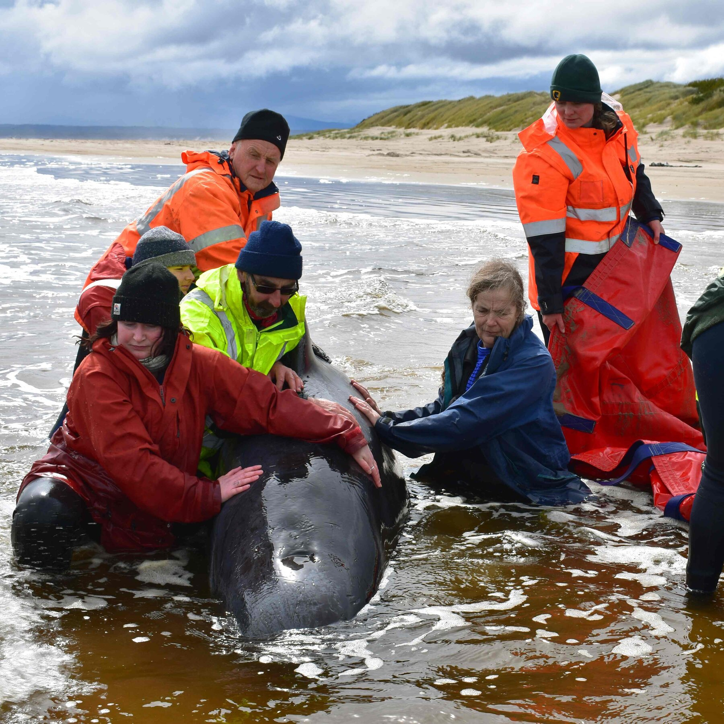
POSSIBLE APPLICATIONS
Whale-watching app
Whale rescue efforts

Slide 25
Thank You!

